Slide 1
MAD-I Final Project
Flash-card App
by
Tushar Supe (21F1003637)

Slide 2
What is Flashcard ?
A flashcard is a card bearing information on both sides, which is intended to be used as an aid in memorization.
Each flashcard bears a question on one side and an answer on the other.
(ref: https://en.wikipedia.org/wiki/Flashcard)

Slide 3
Modules and Languages:
Technology | Purpose
Python | Core programming language of this app
HTML | Creating web pages
CSS | Styling web pages
Javascript | For basic functionalities in web pages like display/hide content, change background color of specific element
flask | Web framework library
flask-sqlalchemy | Library to create sqlite database, to connect with database
flask-login | Library for Login authentication for the app
flask-restful | Library for implementing CRUD API for deck management
Jinja2 | Library for rendering html templates (comes within flask)
requests | Library to send get, post, put, delete requests to API
pandas | Library to create/read/write CSV file
*in-built: os, time, datetime, json, random
*basic: device with web browser and internet connection

Slide 4
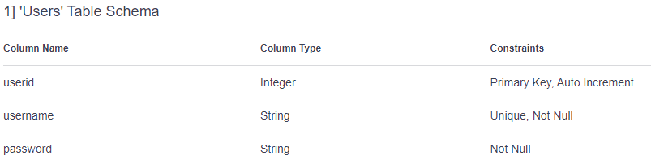
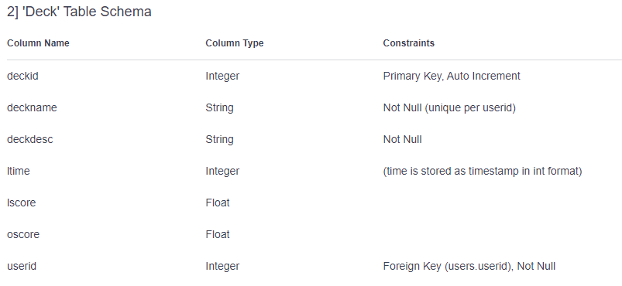
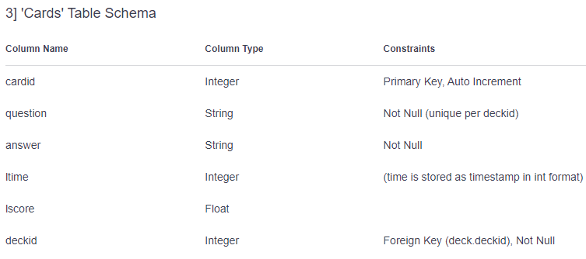
Database Model:

Slide 5
Database Model:
Table name: users
Column | Datatype | Constraint | Description
userid | Integer | Primary key, Autoincrement | Unique user id for every user
username | String | Unique, Not null | Unique user name (can’t be edited once created)
password | String | Not null | Password specified by user
Table name: deck
Column | Datatype | Constraint | Description
deckid | Integer | Primary key, Autoincrement | Unique deck id for every deck
deckname | String | Not null | Unique deck name for same user id
deckdesc | String | Not null | Description of the deck
ltime | Integer |  | Last reviewed time of deck (time as timestamp)
lscore | Float |  | Last reviewed score of the deck
oscore | Float |  | Overall score of the deck
userid | Integer | ForeignKey("users.userid"), Not null | To link user to deck
Table name: cards
Column | Datatype | Constraint | Description
cardid | Integer | Primary key, Autoincrement | Unique card id for every card
question | String | Not null | Front side of card, must be unique per deck
answer | String | Not null | Back side of the card
ltime | Integer |  | Last reviewed time of card (time as timestamp)
lscore | Float |  | Last reviewed score of a card
deckid | Integer | ForeignKey("deck.deckid"), Not null | To link card to deck

Slide 6
REST API:
Resource | Request | Endpoint | Request body | Purpose (for current user)
Deck | GET | /api/deck | - | To get details of all decks
Deck | POST | /api/deck | deckname, deckdesc | To create a new deck
Deck | GET | /api/deck/<int:deckid> | - | To get deck details
Deck | PUT | /api/deck/<int:deckid> | deckdesc | To update deck description
Deck | PUT | /api/deck/<int:deckid> | ltime, lscore | To update last reviewed time, score of deck
Deck | DELETE | /api/deck/<int:deckid> | - | To delete a deck
Deck | GET | /api/deck/<string:deckname> | - | To get deckid from deckname
Cards | GET | /api/deck/<int:deckid>/card/<int:cardid> | - | To get single card details
Cards | PUT | /api/deck/<int:deckid>/card/<int:cardid> | question, answer | To update front and back details of a card
Cards | PUT | /api/deck/<int:deckid>/card/<int:cardid> | ltime, lscore | To update last reviewed time and score of a card
Cards | DELETE | /api/deck/<int:deckid>/card/<int:cardid> | - | To delete a card
Cards | POST | /api/deck/<int:deckid>/card | question, answer | To create a new card

Slide 7
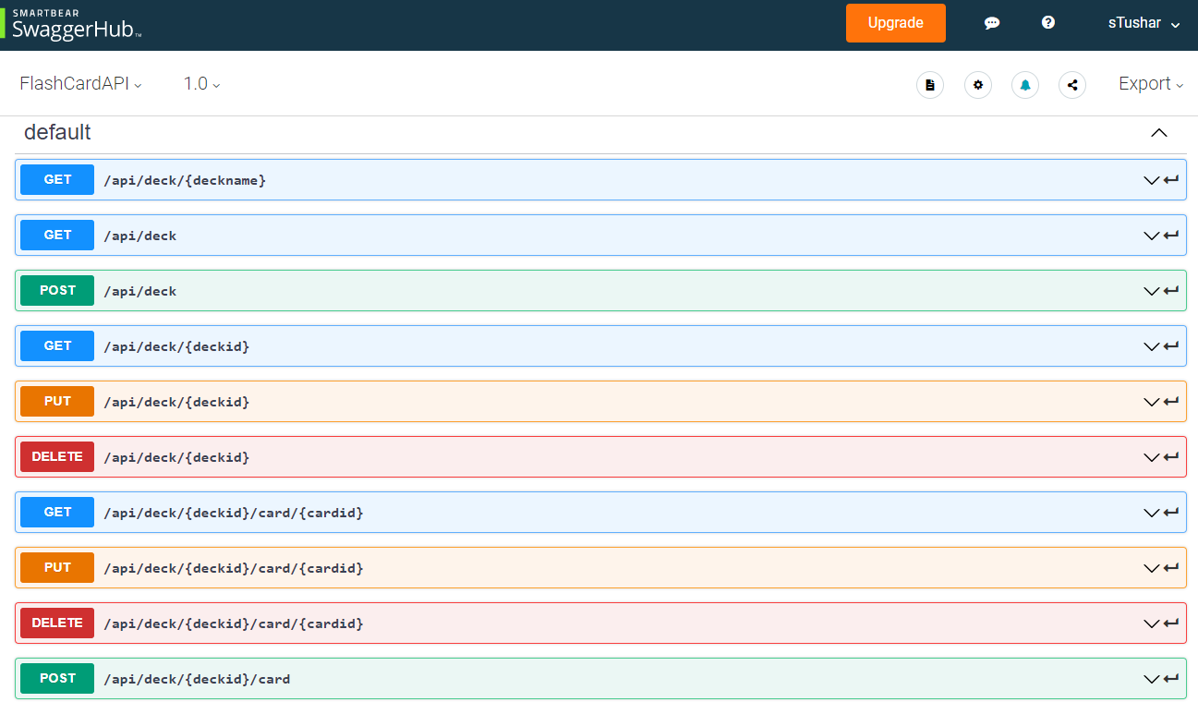
REST API:

Slide 8
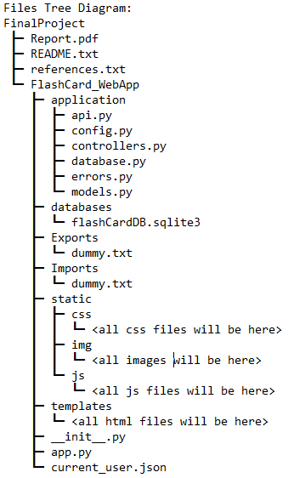
Files Tree diagram:

Slide 9
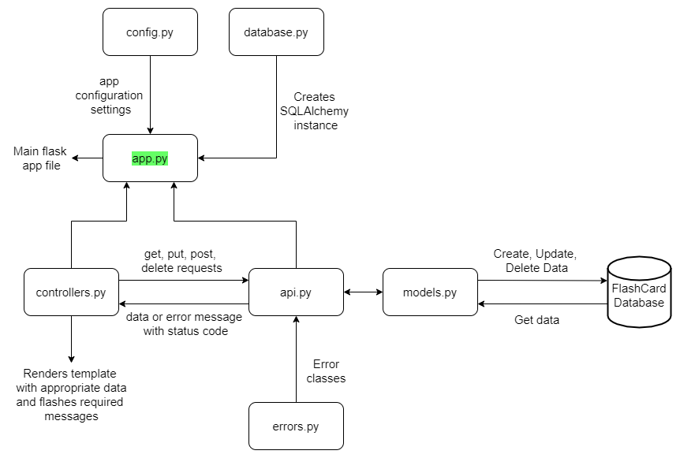
Basic File Structure:

Slide 10
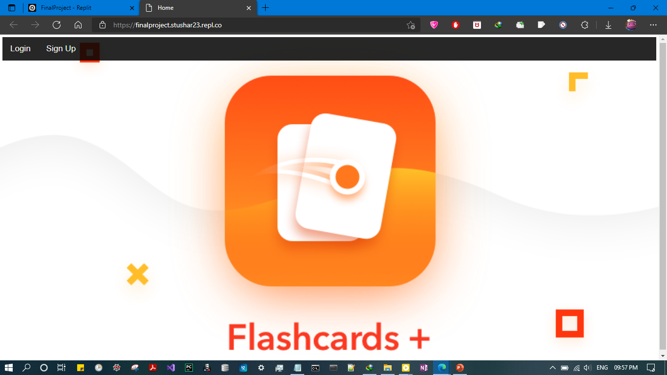
Home Page :

Slide 11
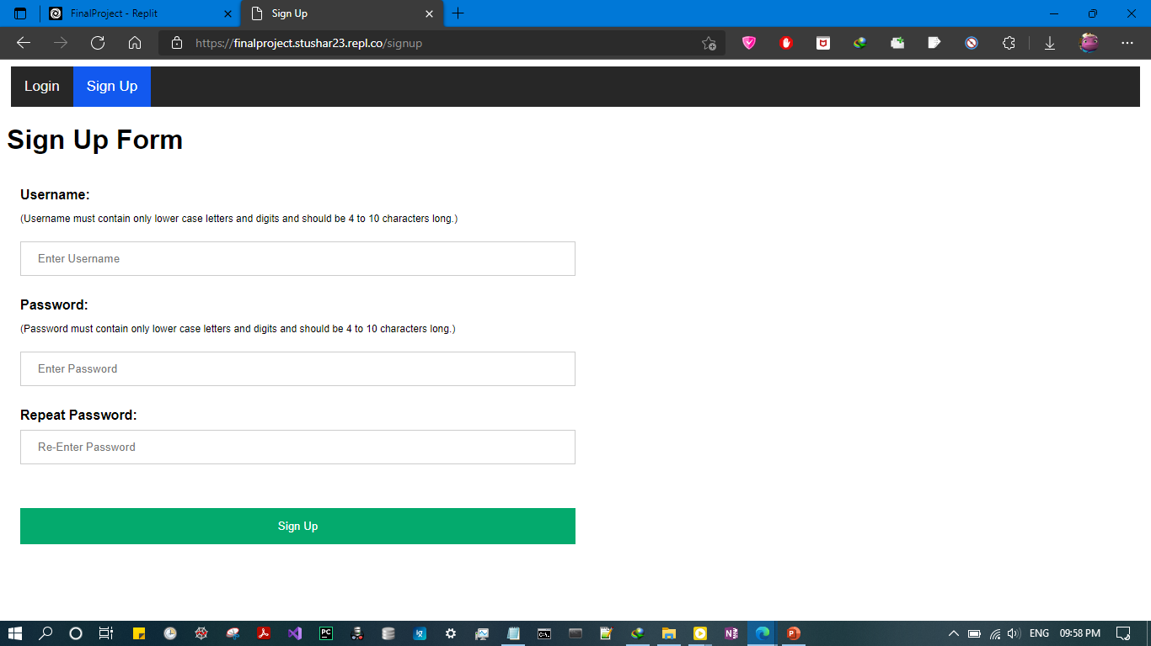
SignUp Page :

Slide 12
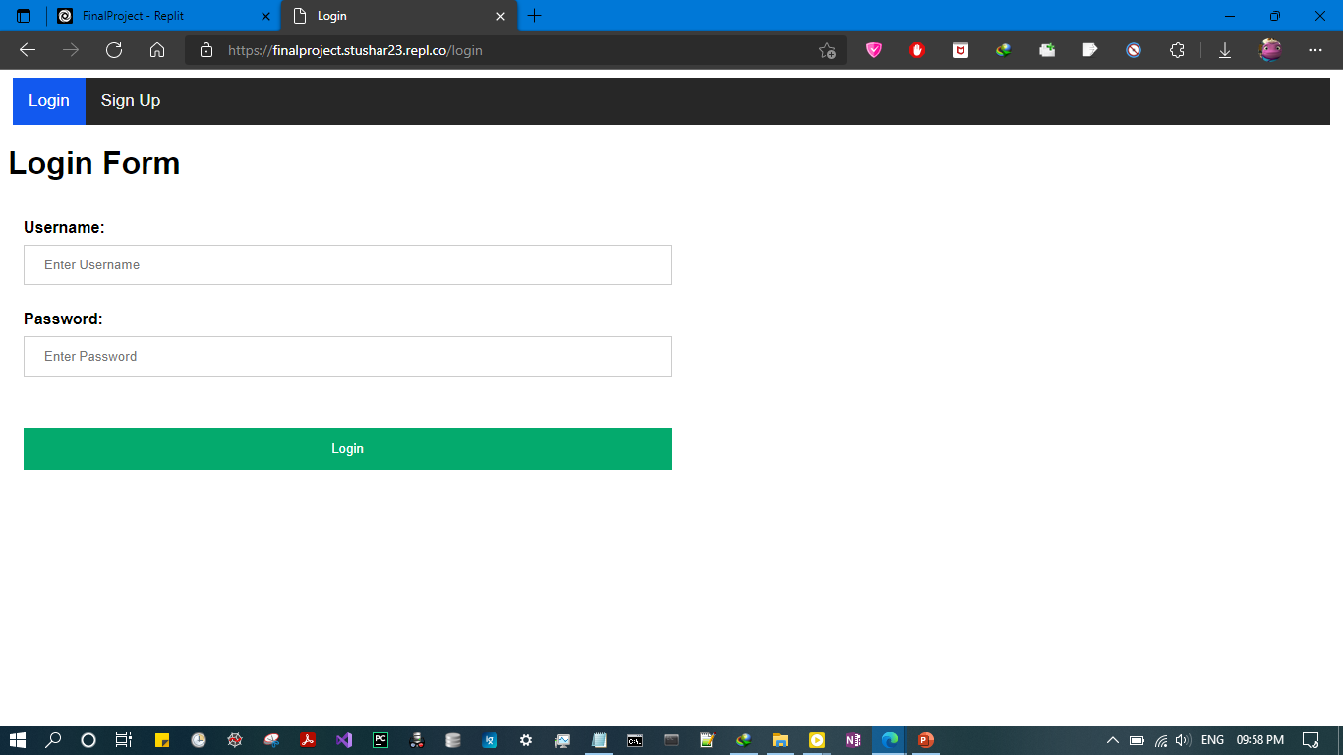
Login Page :

Slide 13
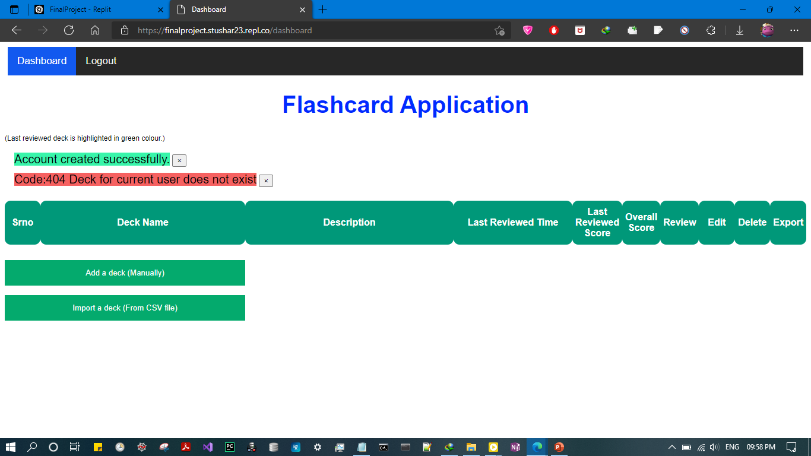
Dashboard Page : *(New user, so no deck added)

Slide 14
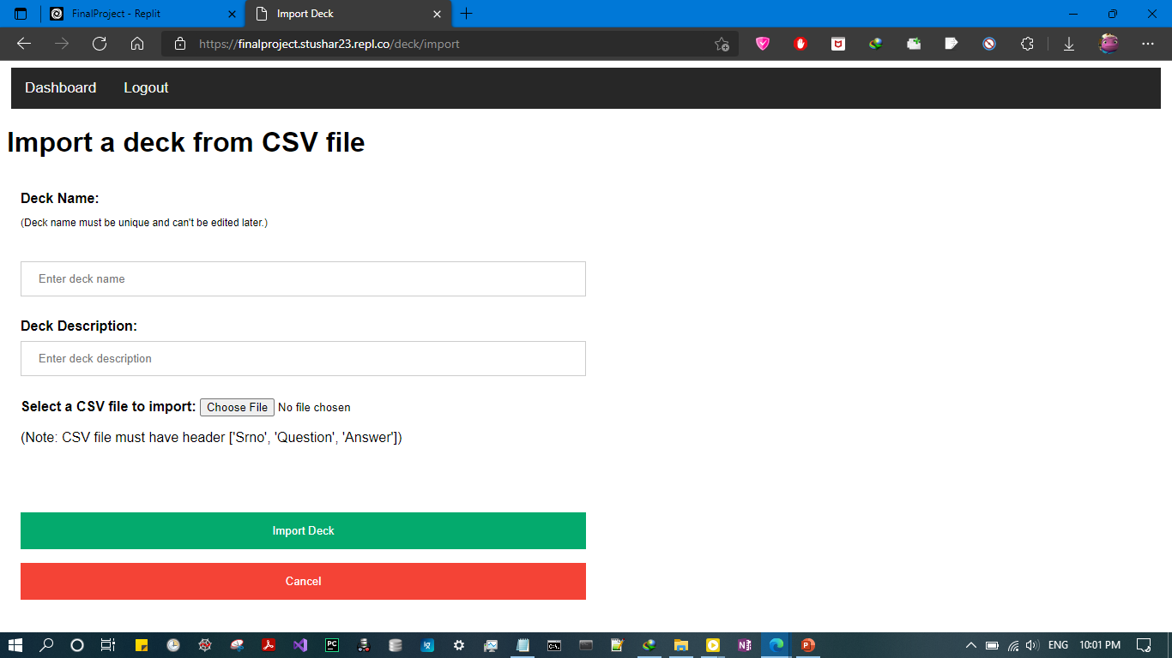
Import Deck Page :

Slide 15
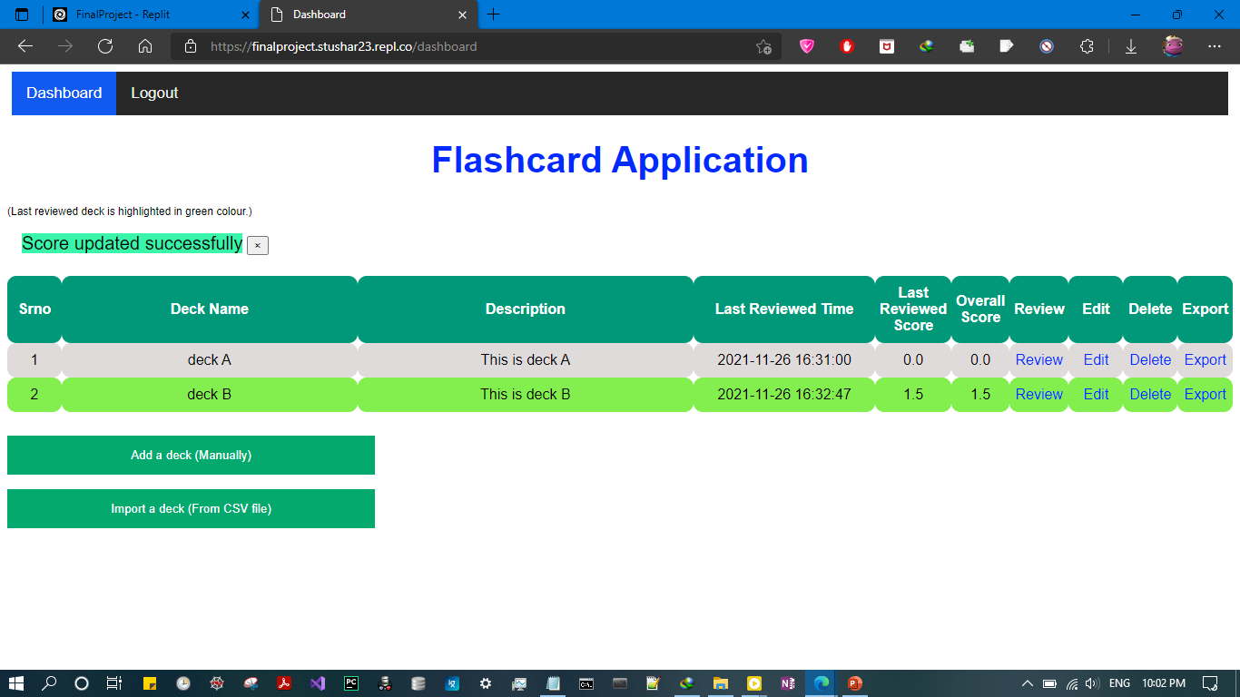
Dashboard Page :

Slide 16
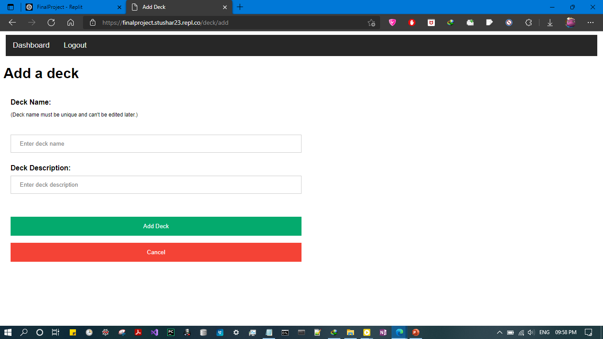
Add Deck Page :

Slide 17
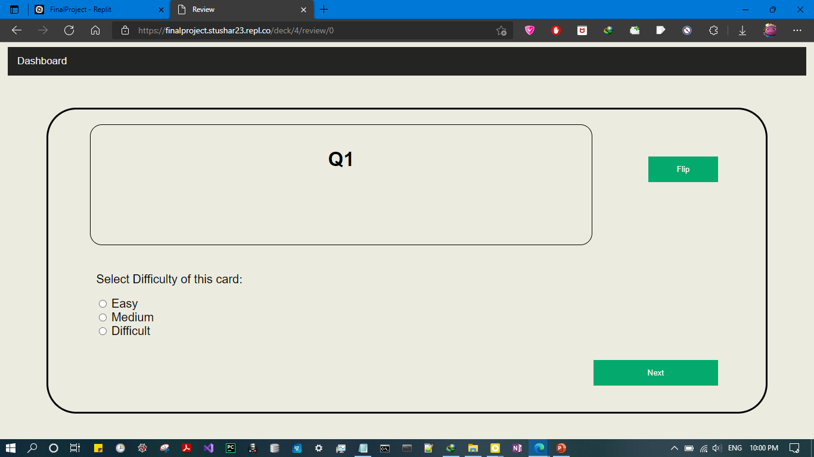
Review Deck Page (Front side) :

Slide 18

Review Deck Page (Back side) :

Slide 19
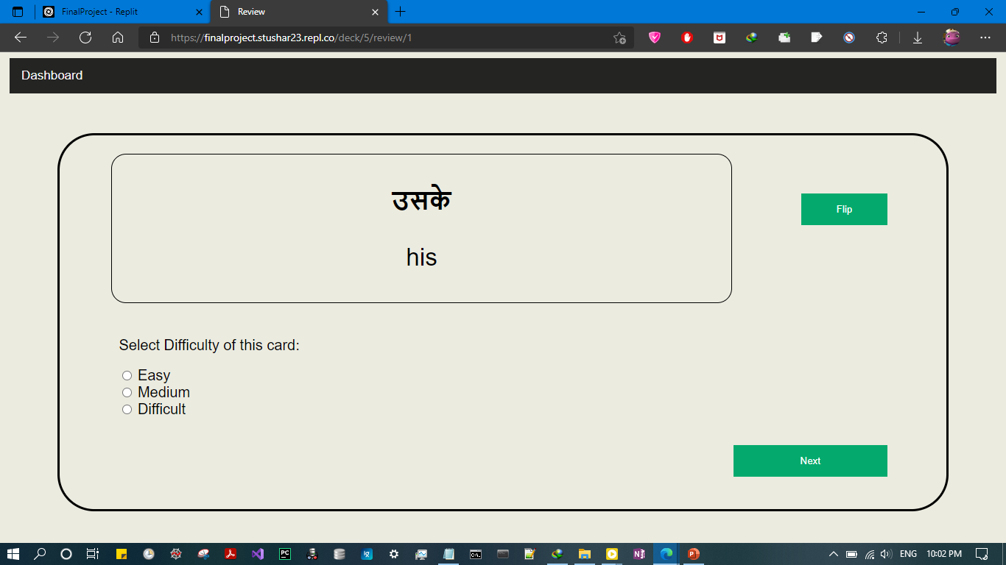
Review Deck Page (Back side) : *(UTF-8 support)

Slide 20
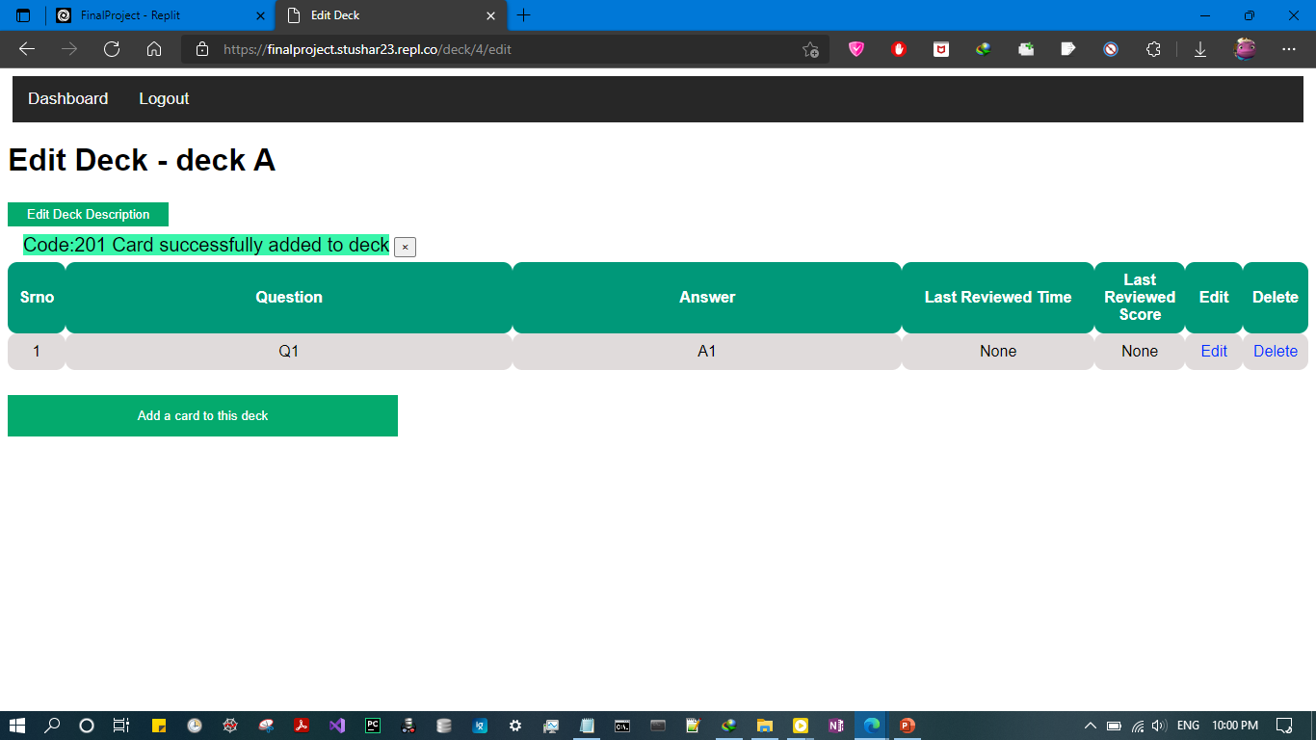
Edit Deck Page :

Slide 21
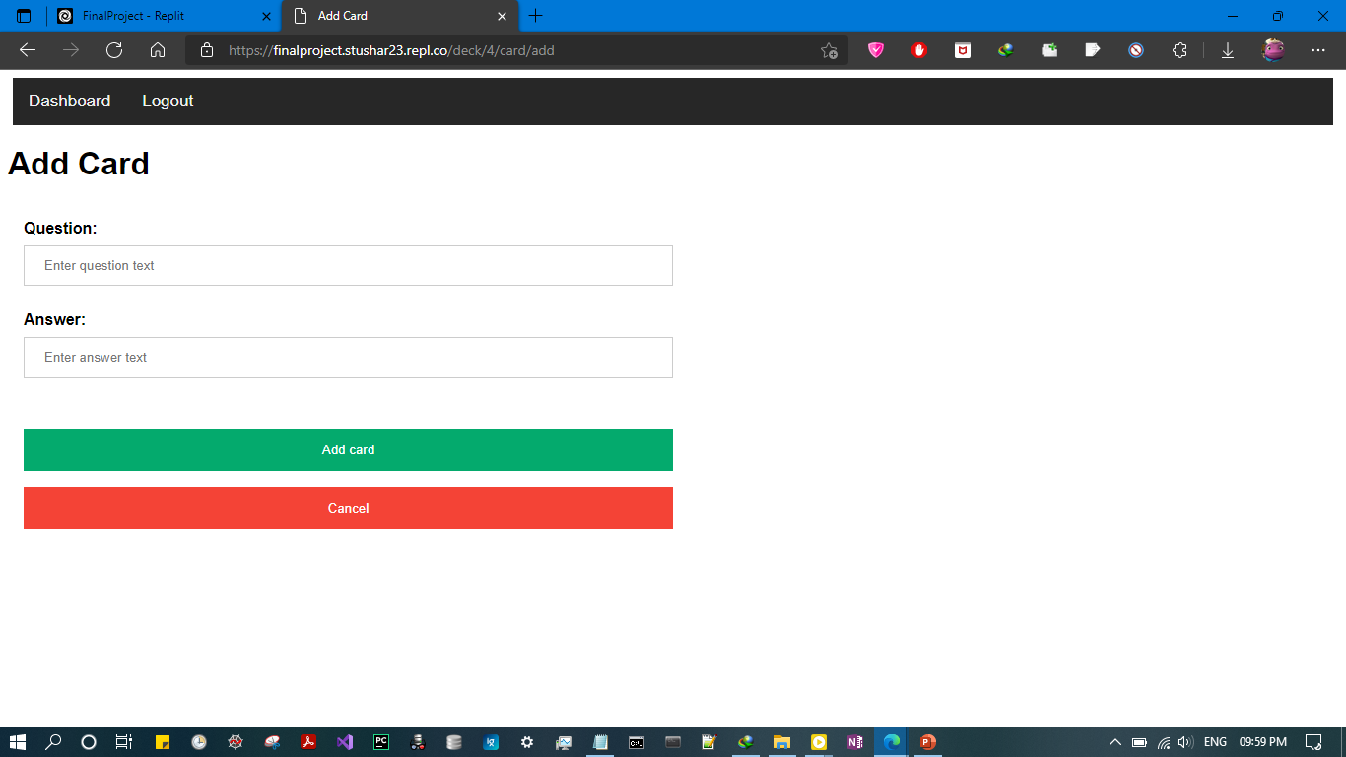
Add Card Page :

Slide 22

Edit Card Page :

Slide 23
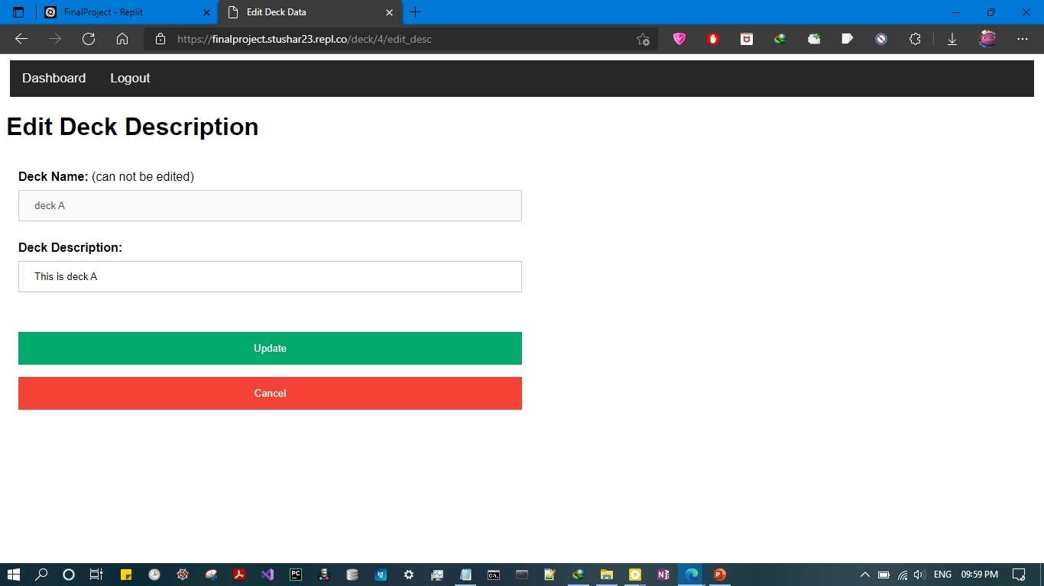
Edit Deck Description Page :

Slide 24
Extra Features:
Proper login system
Importing a deck from CSV file (*csv file must have headers: Srno, Question, Answer)
Exporting a deck to CSV file
Implementation of REST Api for deck-card management
Edit cards question and answer
Edit deck description (*deck name can not be edited as its unique)
Single database to store users, decks and cards (pros: reduced complexity, reduced data redundancy)
Multi language support
Minimalist design

Slide 25
Thank you !!

